Slide 1
Weekly report 10/14/2019-10/20/2019 Tengteng Tao
Work Done
Learn the principles of VDP method and Four-Point Probe Method and acknowledge the difference between them
Learn to operate the Hall effect instrument in CII
Learn to use Origin to plot, analysis and fitting data
Work to be done
Learn to operate VESTA to build models
Use real data to do fitting practice
Keep learning Origin to do more complicated fitting process
`

Slide 2
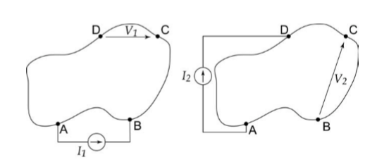
Weekly report 10/14/2019-10/20/2019 Tengteng Tao
VDP Method:
VDP method needs four contacts on the boundary of the material. By measuring the voltage and current during the combination of those four contacts, we are able to calculate the resistance of this sample. The advantage for this method is that we can apply it on a sample with any arbitrary shape. The Hall Effect instrument in CII is based on this method.

Slide 3
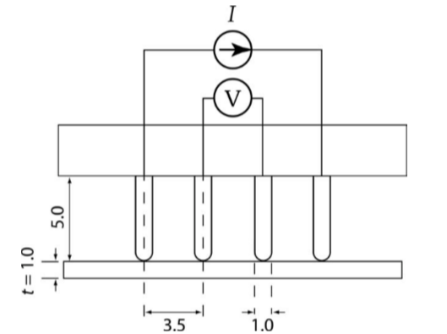
Weekly report 10/14/2019-10/20/2019 Tengteng Tao
Four-Point Probe Method:
Four-Point Probe Method put four equidistant contacting probes on the sample. This method is used to measure an infinite sheet or a sample with a much larger dimensions than the distance between the electrodes.

Slide 4
Weekly report 10/14/2019-10/20/2019 Tengteng Tao
Limitation of the Hall Effect instrument in CII :
The Hall Effect instrument in CII is used for a quick measurement of hall voltage. This instrument has a fixed magnetic field, which is 0.518 T, and only two options for temperature, 77K and room temperature. Accordingly, it is impossible to use this instrument to measure the temperature dependent hall effect and magnetic field dependent hall effect.
I have used the official sample to do practice and found that if operating the instrument with a correct consequence and do a little calculation, the result provided by this instrument is reliable.

